Slide 1
I AM READY

Slide 3
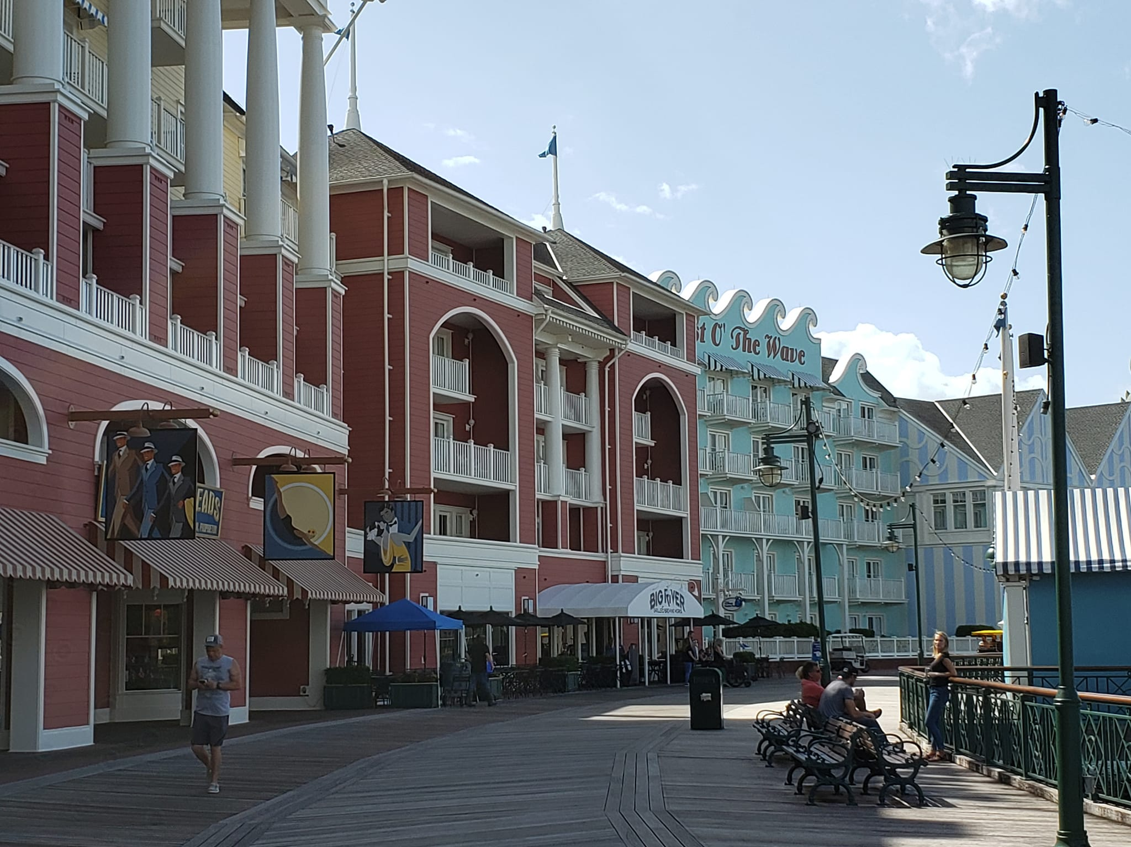
Who? When? Where?
Go For The Greens is a boutique style conference for women business owners
It takes place Sept (25th) 26th-28th, 2024
Held in Orlando, Florida at Walt Disney’s Boardwalk Resort

Slide 4
What is it?
The GFTG’s conference is
Focused on:
Growing women-owned companies
Generating revenue
Sustainability best practices
Making procurement and business connections
Using golf as a business tool.

Slide 5
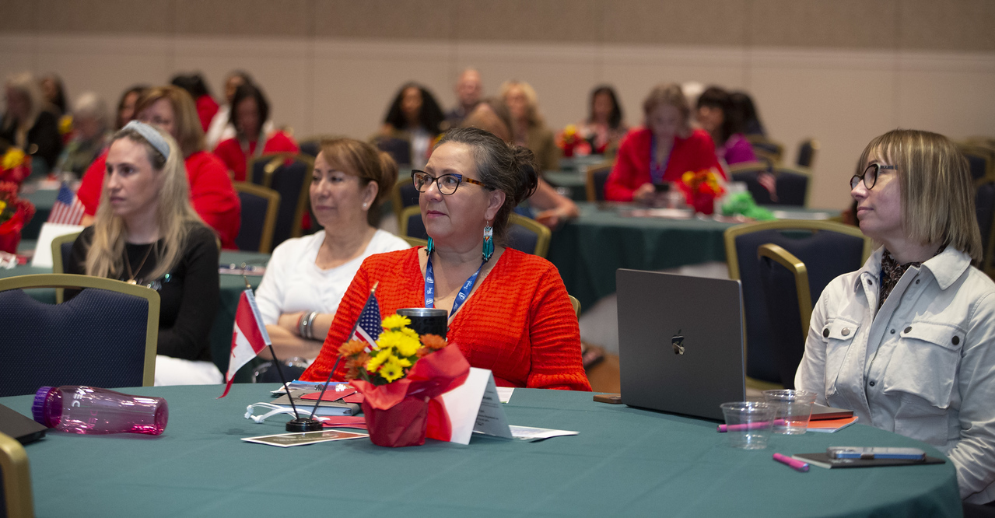
What is unique about GFTG’s
The GFTG’s conference is
Focused on:
Connections with procurement representatives and other business owners.
Small roundtable discussions.
Unique networking opportunities.
Collaborative environment.
Attendance capped at 300
Golf event to foster relationships

Slide 6
Who you will meet
Expect to meet:
Corporates (contract opportunities)
Government (contract opportunities)
Women business owners from across the globe
Future leaders of tomorrow.

Slide 7
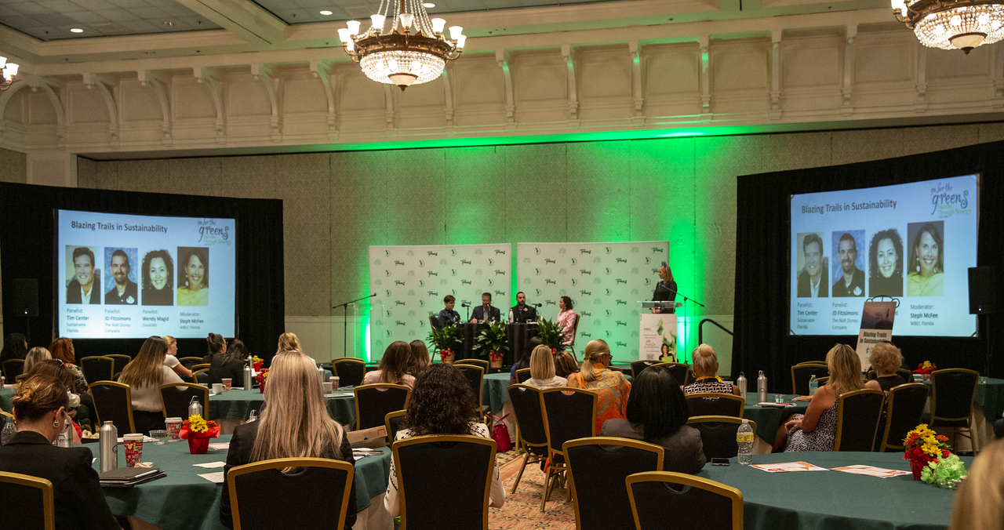
What to Expect
Discover new connections and opportunities
Hear from people who have “reached the stars”
Put into motion your ESG strategies
Learn how AI can change your business and your life
Launch the next generation through mentorship
Propel cross-border business opportunities
Boost relationships by networking through golf

Slide 8
What to Expect
Days will be full of:
Speakers
Educational Programming
Concierge Connections (Interactive Networking)
Go For The Greens Marketplace
Meet and Greets
Golf
And of course FUN!

Slide 9
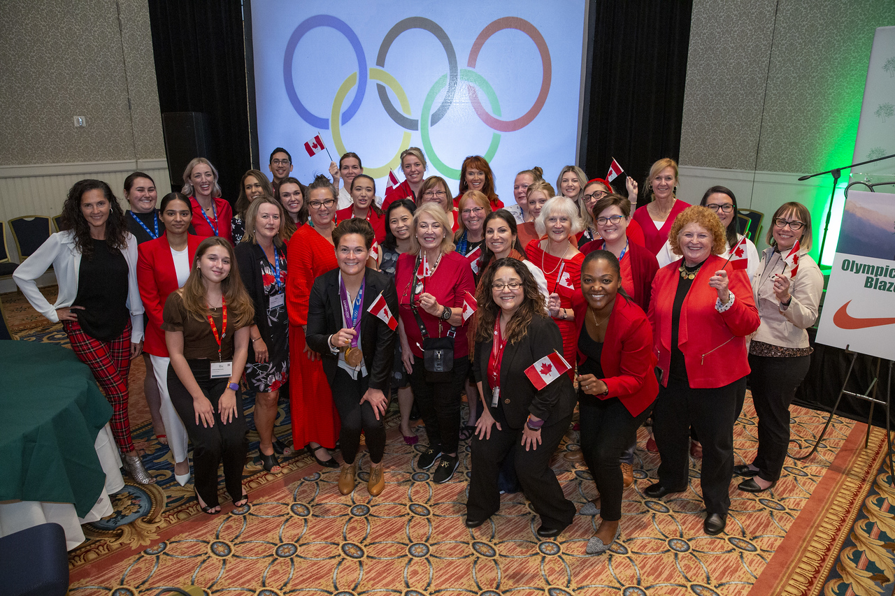
Wear RED!!!! -

Slide 10
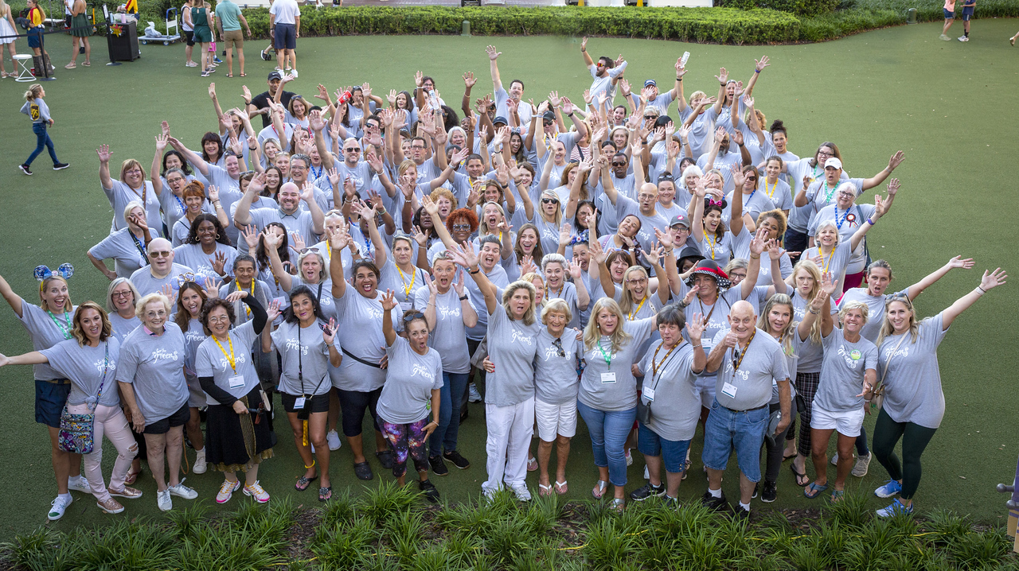
What PARO Trade Delegation does
PARO helps to prepare you through:
Pre-Conference Information Sessions to:
Develop your Capability Statement
Prepare your Pitch and
To be prepared to go
Post Conference follow up session
Team at GFTG’s to support you
Group Chat

Slide 11
Available Funding Options
PARO Funding Options
BIZGrowth (Ontario only)
PARO Circles
WEOC
CANExport (closes May 31st )
Northern Ontario Exports
Innovation Centres
Community Futures Development Corporations (CFDC’s)

Slide 12
Contact:
Karen Evans – trainer@paro.ca
Or Your PARO Business Counsellor or BGA

Slide 13
One Week To Go! Until the Magic Begins!
@PARO.centre
www.PARO.ca
@paro.centre

Slide 14
QUESTIONS?
THANK YOU
Empower yourself and realize the importance of contributing to the world by living your talent. Work on what you love. You are responsible for the talent that has been entrusted to you.
-CATHARINA BRUNS

